Slide 1



AI-Powered Resume Screening System
The AI-Powered Resume Screening System streamlines recruitment by using Deep Learning to analyze resumes. It uses TensorFlow to process experience, skills, and job requirements, ensuring accurate candidate selection. By automating screening, it reduces recruiter effort and enhances decision-making. The model is trained on a dataset of job descriptions and candidate profiles, leading to precise matching.
Data visualization techniques interpret model performance. This system accelerates hiring and contributes to fair candidate evaluation, improving the overall recruitment experience.
by Usman Saeed

Slide 2

Introduction to AI Resume Screening
Organizations face challenges in efficiently screening resumes due to the overwhelming number of applications. Traditional resume screening is time-consuming, prone to bias, and requires manual effort. The AI-Powered Resume Screening System addresses these issues by automating and enhancing the recruitment process using Deep Learning techniques.
This system leverages TensorFlow to analyze resume attributes and match them with job requirements, ensuring accurate and unbiased candidate selection, ultimately saving time and resources.
Reduce Time
Minimize Bias
Automates screening to save time.
Enhances accuracy of candidate selection.
Improve Efficiency
Streamlines the recruitment process.

Slide 3
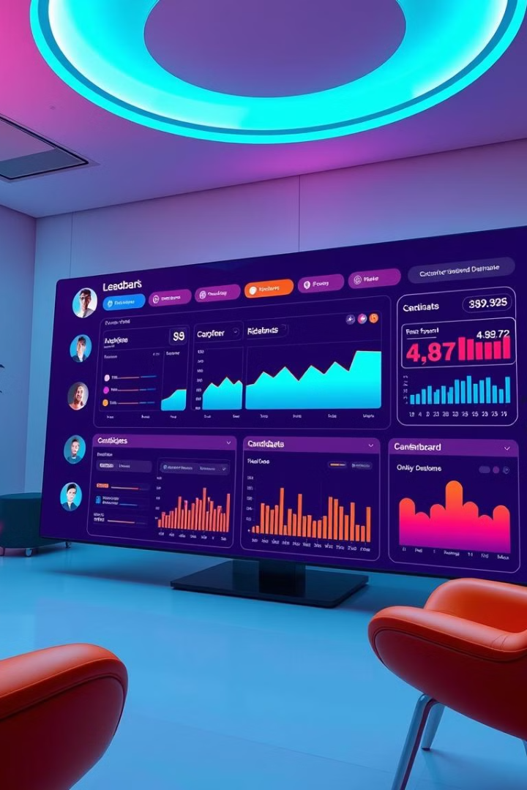
System Overview and Objectives
The AI-Powered Resume Screening System analyzes experience, qualifications, skills, and job-specific requirements. A deep learning model built on TensorFlow evaluates and ranks candidates. Integrated data visualization techniques interpret model performance and provide analytics to recruiters.
The system enhances productivity, ensures fair evaluation, reduces costs, and provides data-driven support. Key objectives include developing an accurate deep learning model, integrating data visualization, and building a scalable system.
1
Enhance Productivity
2
Ensure Fairness
Improves decision-making for recruiters.
Provides unbiased candidate evaluation.
3
Reduce Costs
Lowers recruitment costs and time-to-hire.

Slide 4
Literature Review: Automated Systems
The demand for efficient recruitment has led to AI and ML-based resume screening systems. Traditional methods are labor-intensive and prone to bias, necessitating intelligent systems. Studies show ML algorithms like SVM and Decision Trees improve accuracy and efficiency, but require extensive feature engineering, limiting scalability.
Deep Learning has emerged as a powerful approach due to its ability to learn complex patterns from unstructured text data.
Traditional ML
Deep Learning
SVM and Decision Trees improve accuracy but need feature engineering.
CNNs and RNNs process resume content effectively.

Slide 5



NLP and Bias in Resume Screening
NLP is crucial for understanding resume content. Techniques like word embeddings (Word2Vec, GloVe) and contextual embeddings (BERT) extract features. Combining NLP with Deep Learning improves candidate matching. NLP-based parsing extracts experience, qualifications, and skills from unstructured resumes.
Ensuring fairness and minimizing bias is a major challenge. Biased training data can lead to discriminatory hiring decisions. Fairness-aware models incorporate bias mitigation techniques during training.
NLP Techniques
Bias Mitigation
Word embeddings and contextual embeddings for feature extraction.
Fairness-aware models reduce bias during training.

Slide 6
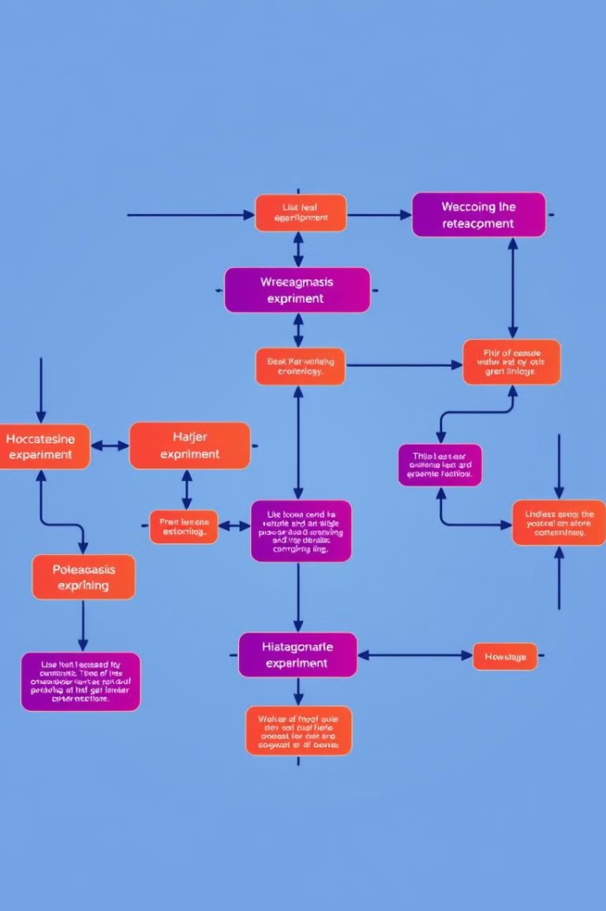
Experiment Design and Methodology
The experiment develops and evaluates an AI-powered Resume Screening System using Deep Learning to automate shortlisting. It assesses accuracy, efficiency, and bias minimization. The system uses TensorFlow and is trained on a dataset of job descriptions and candidate profiles.
The methodology includes data preprocessing, model selection, training, and performance evaluation. Tools used are TensorFlow, Pandas, NumPy, NLTK, Matplotlib, and Seaborn.
1
Data Preprocessing
Cleaning and normalizing text data.
2
Model Training
Using DNN architecture with multiple hidden layers.
3
Performance Evaluation
Calculating accuracy, precision, recall, and F1-score.

Slide 7



Code Implementation and Evaluation
The code implementation includes data loading, preprocessing, feature extraction, model building, training, evaluation, and visualization. TensorFlow is used for Deep Learning, and NLP techniques analyze resume content. The model is trained and evaluated, with accuracy and loss metrics visualized using line plots.
The confusion matrix provides insights into classification performance, and the classification report displays precision, recall, and F1 score.
Data Loading
Visualization
Loading data from CSV files.
Plotting accuracy and loss metrics.

Slide 8



Discussion: System Performance
The model achieved high accuracy during training and testing, demonstrating its capability to learn complex patterns from resumes. Dropout layers effectively minimized overfitting, resulting in reliable predictions. However, the model's performance varied across different job roles, highlighting the importance of job-specific features and contextual understanding.
2
Effective Regularization
1
High Accuracy
Job-Specific Features
3

Slide 9
Limitations and Ethical Considerations
The model relies on feature extraction, which may not capture context in resumes. Data imbalance affects model performance, requiring oversampling techniques. The model performs well for general roles but shows limitations in specialized industries.
Ethical concerns include data privacy, transparency, and bias. Fairness and preventing discrimination are essential. Mitigation strategies include fairness-aware algorithms and regular auditing.
1
Contextual Understanding
2
Data Imbalance
3
Ethical Concerns

Slide 10

Conclusion and Future Enhancements
The AI-Powered Resume Screening System demonstrates the potential of Deep Learning to revolutionize recruitment. It efficiently shortlists candidates, reducing manual effort and minimizing bias. Future enhancements include advanced NLP techniques, fairness-aware algorithms, and cloud deployment.
By ensuring transparency and ethical considerations, this system modernizes recruitment practices and enhances organizational efficiency. The system provides a reliable and scalable solution for intelligent resume screening.
95
% Accuracy
Achieved in shortlisting candidates.
50
% Time Saved
In manual resume screening.

